Slide 1

2019 BTWC Meeting of Experts
OFFICIAL

Slide 2
Emergency response to an infectious disease outbreak
UK operational principles for responding to a CBRN attack may be helpful for:
  Other states parties in building their own national capacities
  Helping to shape an international response under Article VII
OFFICIAL
Notes:
We are part of the agenda to discuss (italicised statement).

Slide 3




National CBRN Centre - Who are we?
Chief officers from the police, fire and ambulance services lead our strategy in partnership with Counter Terrorism Policing, military and government.
We work together to support, strengthen and assure a resilient CBRN capability for the UK.
OFFICIAL

Slide 4
Governance - National CBRN Strategy
UK GOVERNMENT – CONTEST STRATEGY
COUNTER TERRORISM POLICING
NATIONAL CBRN LEADS
(POLICE/FIRE/AMBULANCE)
NATIONAL CBRN CENTRE
COUNTER TERRORISM NETWORK
EMERGENCY SERVICES
OFFICIAL
Notes:
Governance – Clear framework required prior to any event – provides clarity as to responsibility but also legitimacy and accountability.
Where we sit – national CBRN centre as part of CONTEST – Protect, Prevent, Prepare and Pursue
Multi-agency but also embedded within CT Policing structure
Key element to note here, which will be reiterated throughout the presentation – the CBRN response must be part of the wider CONTEST strategy. It does not sit alone as a silo.

Slide 5
UK approach to a CBRN incident
There will be a different priorities and considerations for the response should it be:
An overt, deliberate release of an infectious biological agent
A suspected covert release or natural outbreak
OFFICIAL
Notes:
The focus of this presentation is to examine how the CBRN response model can accommodate an overt, deliberate release, where the origin or point of release is known. It is in this type of scenario we can begin to outline how the UK would respond in an emergency situation.
That is not to say our remit does not also cover the second scenario. In the case of a covert release
Counter Terrorism Policing would be closely linked with the health authorities, both organisations leading in different areas of the response. There are circumstances, of course, in which we would not know whether the release had been deliberate, or not. But clearly, in the case of a natural outbreak of an infectious disease such as pandemic flu, we would certainly expect the health authorities to take the lead, with ourselves providing logistical and public order support where it may be needed.

Slide 6
UK specialist CBRN response
  Tiered framework – national, regional to local
  Operational advice and support
  Tested, exercised specialists with robust training
  Personal protective equipment designed to the highest global standards
  Operational multi-agency response
  Support from world-leading science reachback
OFFICIAL
Notes:
The UK Specialist CBRN response is in place. The National CBRN Centre continues to manage investment into world-leading research on safe ways of working and supporting technologies.

Slide 7
CBRN event model
Normality
Prepare
S
T
R
A
T
E
G
Y
Recovery
Period
Incident
IOR
Transition
SOR
OFFICIAL
Notes:
Recognised format the style has been taken from the disorder model (PO)
IOR embedded? Daily Business IDL ICE White Powder
IOR Swimming Pool Chlorine incident could we deal with it ? Is it recognised that this is a likelihood and therefore daily business fro the Blue light services should we be able to deal with this event effectively.
Once we go past this stage or type of event the recovery time is significant (Major / Critical Incident) for instance the Forensic investigation, the Hazard Management, People Management, Decon of Environment to recovery period to Normality or in certain circumstances a new normality.
(IOR to SOR transition).
What do we need to deal with a CBRN event? The old Model Response manual never accounted for this transition it was all or nothing.
It therefore stifled Commanders considered decisions and wasn’t proportionate, flexible or realistic in order to work together to save lives and reduce harm.

Slide 8
Gather Information & Intelligence
Take Action and Review what Happened
Assess Risks and Develop a Working Strategy
Working Together
Saving Lives Reducing Harm
Identify Options & Contingencies
Consider Powers Policies & Procedures
OFFICIAL
Notes:
Cycle starts with Central hub reveal then clockwise around the model

Slide 9
UK approach to a CBRN incident
Minimise loss of life and injury to the public
Make the scene safe and secure to protect the wider community, preserving evidence at the scene
Support and facilitate the handover to wider investigation
Support & facilitate wider consequence management (survivor assistance / remote casualty management)
Support and facilitate humanitarian assistance and wider consequence management
Support and facilitate handover to recovery activities
Inform the public and maintain public confidence
OFFICIAL
Notes:
Once the emergency services are informed, this is the UK approach to a CBRN incident.
We deal with potential biological incidents regularly – white powder incidents, groups of people displaying concerning symptoms, suspected poisonings, etc.

Slide 10
Realistic
7
Key Criteria for an Effective Response
Robust
Effective /
Timely
Proportionate
Interoperable
Scalable
Flexible
OFFICIAL
Notes:
Home Office Framework Document and Doctrine identified Key Criteria for the effective response to a CBRN event.
The 9 key tasks were found to be applicable in the main to a Mass Casualty Event and as such did not support Commanders decisions and were not proportionate to the events that were happening around the country. Further more it was based on the Police doing everything.
The question should be asked what do you think our response should be? IOR? = Multi Agency utilising differing levels of PPE / kit
It is recognised that a CBRN event / incident is not only a mass casualty event.
The evidence suggests that CBRN events are evidentially small scale with the potential if not managed correctly to become mass casualty highly complex events.
Your expertise is critical to effectively dealing with these events.
Mass Casualty events still need to be factored in however the vast majority of events are small scale events with management challenges no different to daily business.
It is no longer enough to plan we must ensure that our plans are updated on a regular basis commensurate with ever changing threat.
Terrorists will always be motivated, incentivised and have clear set strategies. We must all endeavour to identify their aims and objectives the way we do this is by intelligence and evidence gathering. Before an event during an event and post event. In order to reduce the vulnerability and impact on our country.

Slide 11
Shared Situational Awareness
Co Locate
JESIP
Principles
of
Joint Working
Jointly Understand
Risk
Communicate
Co-ordinate
OFFICIAL
Notes:
Incidents evolve, each event is unique and decisions have to be made in a sometimes Rapidly evolving constantly changing environments where information is not immediately available.
Co Locate The initial phase of Command and Control element must be positioned in a location that is appropriate to the incident.
Communicate Consideration should be given to the setup of a JESIP Talk group. This will help to facilitate prompt assessment of threat and risk and prioritise actions.
Co-ordinate The Police may well be the default agency to facilitate this function however where it is identified they will support an identified lead agency based on the specific event.
Jointly Understand Risk Each agency will undertake their own RA however in order to make effective appropriate decisions it is incumbent on Commanders to assimilate all the necessary information so that their decisions take into account a hiarachy of needs based on the central hub of the JDM.
Shared Situational Awareness this is the result of proper consultation between all agencies recognising the information and threat level at any one time.

Slide 12
On Scene Commander Considerations and Options
LEFT TO RIGHT
Confirm
People Management
Hazard Management
Scene Management
Decontamination
IOR
Evacuate/Invacuate
Monitor Threat
FCP/RVP
Casualty
Top to Bottom
Mapping
Rescue
Mitigation
Responder
Transition
I.C.G.C
Suspect
Cordons
Render Safe
Assessment
Communication
Final Disposition
Emergency Vehicle Management
Deceased
Locate Detect Classify
Casualty Triage
Traffic Management
Disrobe
Improvised
Casualty Management
Evidential
Opportunities
Permissive Environment
Interim
Survivor Management
Intelligence Opportunities
Mass
Hazard Limitation
Clinical
Suspect
Management
Hot Zone Tasking
Evidence Management
SUP
DBB
Deceased
Management
Property Management
5 Safety Critical Considerations
Secondary Threats / Hazards
Responder Rescue
Safe System of Work
PPE
Scientific Advice
CBRN Mass Casualty Response
Notes:
5 On Scene Commander Considerations and Options Headings.
Strands reflect actions Common to a CBRN event.
Consider asking delegates to reflect on their specific and combined MA responsibilities.
Point out that we do not deal with events in a A to Z format we select and prioritise based on the individual event which can be large or small scale with the potential to become large.
Specific responses need to be developed based on the info / intel and employed in sometimes rapidly evolving resource scarce situations.

Slide 13



Enabling the public to help themselves
  What happens in those first few seconds, minutes, hours?
  What has been put in place before the incident?
  What can they do in the early moments of exposure?
OFFICIAL
Notes:
We deal daily with incidents involving members of the public with unexplained symptoms and substances which could be hazardous.
Our emergency services are trained to recognise situations whereby a release of a hazardous substance may have occurred (Steps 1-2-3+, RRR).
It is our first line of defence, to recognise situations which do not feel right, to encourage people to act before a contaminant or infectious agent can spread further.

Slide 14
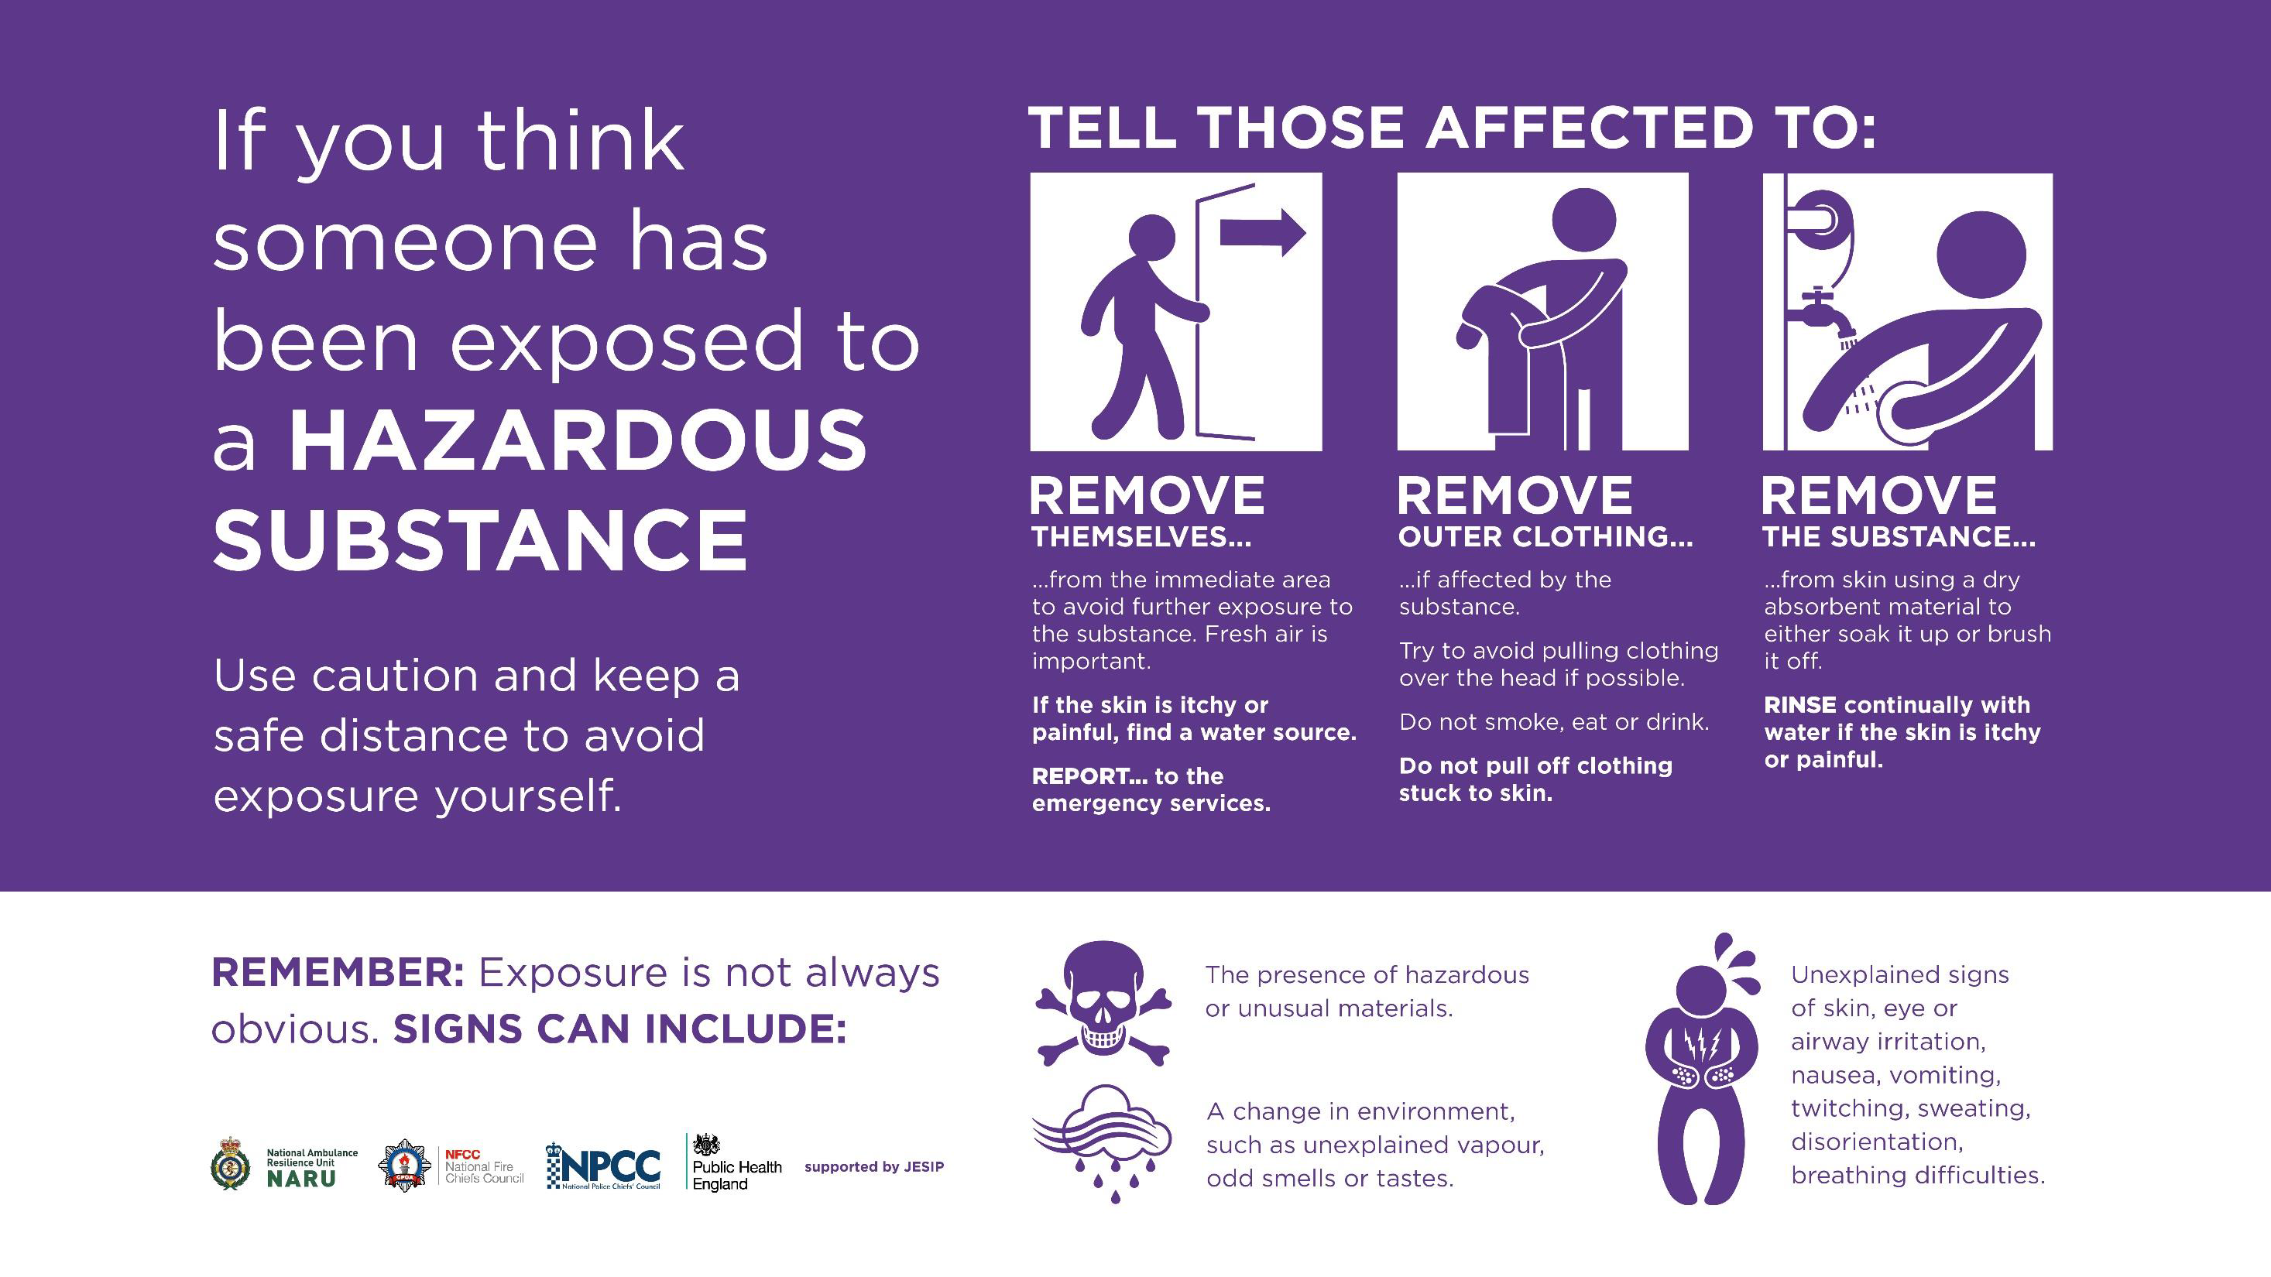
Notes:
Importance of simple messaging – initial advice same for all incidents irrespective of classification – ECHR rights to life therefore need to do something which can be easy to understand.
Do something not Do Nothing is important.
Corrosives, crime, this is not designed for terrorism – hazardous materials guidance
However – it is about teaching people to recognise symptoms and signs, and to act quickly to protect themselves and others
Clear guidance for the protective security sector and the emergency services which we test and assure

Slide 15

Multi-agency communications principles
Who do the public trust most?
OFFICIAL
Notes:
Research shows the public are most likely to trust a local spokesperson, and in addition, a health representative in these situations.
When dealing with the early stages of an overt outbreak, whatever the substance – it is essential that early advice is basic, straight-forward and provides simple first-aid principles.

Slide 16
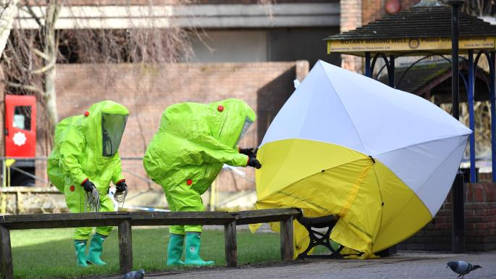
Consistent messaging from earliest point
You’re fine…
OFFICIAL
Notes:
If basic first aid principles have been communicated, the ensuing actions by the emergency services make sense, and provide reassurance.
Without early advice, chaos, confusion and uncertainty can cause long-term issues regarding future communication and trust/confidence from the public in the response and ability of the emergency services to act.
It will also affect the levels of compliance by potential casualties.

Slide 17
What is important?
    Adaptable response models, shared across the emergency services
    Consistent, flexible communication strategy
    Strong relationships with health agencies
    Operational interoperability with health, military, UKIC and counter terrorism network
    Partnering with communities, improving multi-agency planning across local government
    Continuous testing and exercising across agencies
    Industry partnerships, working together to develop technological solutions to mitigate the threat
OFFICIAL

Slide 18




OFFICIAL

